Slide 1
Surgical Processes
Tokyo Women’s Medical University
Cardiovascular Surgery Department
Hiroyuki Tsukui

Slide 2
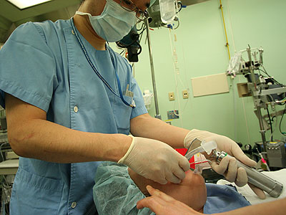
General Anesthesia by Anesthesiologist
Lose consciousness
Does not feel any pain
A tube is inserted through mouth and connected to a ventilator
Procedure will take about 1 hour
Intravenous drip
Monitor

Slide 3
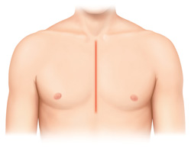
Median Sternotomy
Make an incision of 20-25 cm in the middle of the chest
Cut the sternum underneath the skin

Slide 4
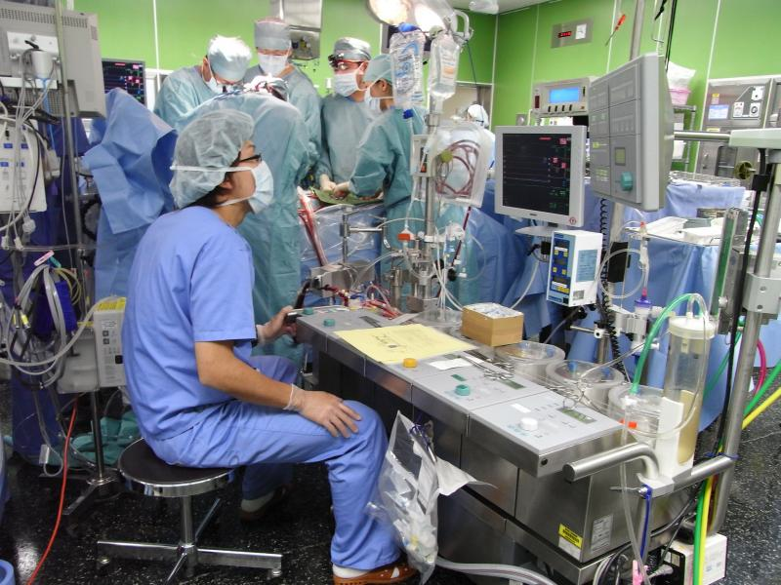
Cardiopulmonary Bypass Machine
For surgery that requires stopping the heart, a machine (Cardiopulmonary bypass machine) that sends blood to the body instead of the heart while it is stopped is connected.

Slide 5
Aortic Block and In-heart Operation
Inject cardioplegic solution to stop the heart.
Perform necessary surgical operations while the heart is stopped.
Coronary artery bypass surgery
Valve repair
Valve replacement, etc.

Slide 6
Return Of Spontaneous Circulation
Release the aortic block and restart the heart.
When the heart is able to pump enough blood, cardiopulmonary bypass machine is removed.

Slide 7
Stop Bleeding・Close Chest
Make sure there’s no bleeding.
Close the breastbone with wire.
Normally, the wire inside the body is left after the surgery.
The skin is stitched up.

Slide 8
Transport to ICU and Visitation
At the time of the initial visit, the patient is not awake from anesthesia and is not conscious.
Ventilator, monitor, intravenous drip, drain etc. are connected.
If the patient is stable, the family can now leave the hospital.
The patient will usually wake up at the night of the surgery or the next morning.

